Slide 1
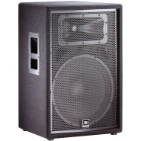

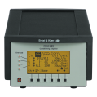
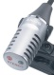
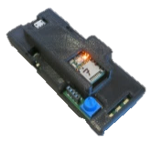
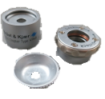
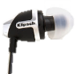
End-to-End Calibration
Speaker
Room Mic
DAQ
Coupler Mic
Mic
Electronics
Earbud
2cc Coupler
Tympan

Slide 2
PCB Mic -> Klipsch Earphones

Slide 3
Sony Mic -> Klipsch

Slide 4
Knowles Mic -> Klipsch

Slide 5
Room Mic
DAQ
Coupler Mic
Mic
Electronics
Earbud
2cc Coupler
Tympan

Slide 6
End-to-End Noise Floor

Slide 7
Noise Floor: PCB Mic -> Klipsch

Slide 8
Noise Floor: Sony Mic -> Klipsch

Slide 9
Noise Floor: Knowles Mic -> Klipsch

Slide 10
End-to-End Noise Floor Summary

